Slide 1
AI-assisted Coding with Codeium
Presenters: Giulia Crocioni, eScience center
Olga Minaeva, NWO-I

Slide 2
Workshop agenda
Introduction to AI in coding (20 min)
Overview of coding assistants
Code generation and optimization
Command function and practical exercises
Break
Chat function and practical exercises
Autocomplete function and practical exercises
Context awareness
Break
Data security and ethical considerations (40 min)
Practical exercises (15 min)
Wrapping up and Q&A (10 min)

Slide 3
Main objectives:
Familiarize with the concept of AI coding assistants, available tools, and capabilities
Learn to generate code and optimize its performance using an AI coding assistant
Recognize, evaluate, and mitigate ethical and security considerations when using AI coding assistant

Slide 4
AI coding assistants rely on ML techniques (deep learning and NLP)
Trained on public code and documentation to understand patterns, syntax, and code logic
Data collection
Gathering a large amount of code, documentation, and natural language conversations to train the Al model on.
Model architecture design
Designing the neural network architecture that will power the AI code assistant.
Pre-training the Al model on the collected data to develop a general understanding of code, programming concepts, and natural language.
Fine-tuning
Evaluation and iteration
Pre-training
Further training the pre-trained model on specific datasets and tasks related to code generation, code completion, and natural language programming.
Testing the AI code assistant on a variety of use cases, then iterating on the model architecture and training process to improve performance.

Slide 5
AI coding assistants rely on ML techniques (deep learning and NLP)
Trained on public code and documentation to understand patterns, syntax, and code logic
Context awareness to suggest relevant code
NLP to interpret natural language
Learning from user interaction (i.e., adjusting to individual developer preferences and coding styles)
Code generation and refactoring
Multilanguage support

Slide 6
Areas of application
Intelligent Code Completion:
Reducing the time spent on routine typing tasks
2. Real-time Error Detection:
Allows to fix issues before execution, enhancing code reliability.
3. Code Refactoring Suggestions:
Analyze existing code and propose optimizations
4. Automated Documentation Generation:
Can generate documentation snippets based on the code, reducing manual effort
5. Collaboration Enhancement:
Version control integration and shared code analysis promote teamwork
Notes:
Intelligent Code Completion:
Al-powered code editors offer advanced suggestions to complete code snippets, reducing the time developers spend on routine typing tasks.
Context-aware completions improve accuracy by considering variable names, function calls, and relevant syntax patterns.
2. Real-time Error Detection:
Immediate identification of syntax errors and potential bugs allows developers to rectify issues before execution, enhancing code reliability.
3. Code Refactoring Suggestions:
Al algorithms analyze existing code and propose optimizations, suggesting improvements in terms of readability, efficiency, and adherence to coding standards.
Automated refactoring assists developers in maintaining clean and maintainable codebases.
4. Automated Documentation Generation:
Al-powered code editors can generate documentation snippets based on the code, reducing the manual effort required for documentation.
Ensures that code changes are consistently documented, promoting better collaboration and knowledge sharing.
5. Collaboration Enhancement:
Features such as version control integration and shared code analysis promote seamless teamwork.

Slide 7
Challenges
Balancing accuracy and speed
Adaptability to different coding styles
Ensuring user privacy and security
Limited context awareness
Unclear Al behavior (the “black box” nature of AI coding assistants)
Notes:
1. Balancing Accuracy and Speed:
Striking a balance between providing accurate suggestions and maintaining a responsive user interface is a key challenge.
3. Adaptability to Different Coding Styles:
A. Developers often have varied coding styles and preferences. Al-powered code editors need to adapt to these differences to provide personalized and effective assistance.
4. Ensuring User Privacy and Security:
A. Handling sensitive code and ensuring the privacy of proprietary algorithms pose significant challenges.
5. Limited Context Awareness:
B. Inability to understand the intent and purpose behind code can result in irrelevant or unhelpful completions.
3. Opaque Al Behavior:
A. Many editors lack transparency in how Al works, leaving developers unsure of the rationale behind suggestions or potential biases in the models.
B. This lack of explainability can hinder trust and acceptance of Al assistance.

Slide 8





 | GitHub Copilot | Codeium | Amazon Q Developer | Tabnine | Hugging Chat
Key Features | Integration with GitHub ecosystem Code completion and context-aware suggestions | Advanced code completions Code refactoring capabilities | Code recommendations Security scans for vulnerabilities | Robust autocompletion AI-powered chat using multiple models | Open-source model integration High flexibility in deployment
Supported languages | ~40 (primarily Python, Ruby, JS, C#) | 70+ languages, including Python, R, Ruby, HTML, Java, C#, SQL | 18+ languages, including Python, Java, JS, C# | 25+ languages | Various languages, including Python and Java
Security | Processes code snippets locally, code remains private and secure | Never train generative model on private code | Doesn't use customer content for service improvement | Never train generative model on private code | Private repositories, access tokens, commit signatures, malware scanning
Pricing | Free for students Monthly fee $10/month | Free forever for individuals Paid version $10/month | Free tier with basic features Paid tiers $19/month | Free version with limited features Pro version $12/month | Free access to open-source models Paid options $9/month

Slide 9
Using Codeium as a Coding Assistant
Command:
Request changes to a code in plain language.
You can accept, reject, or adjust suggestions as needed.
Chat:
Allows to ask questions and get answers using simple, everyday language.
Useful when working with new or unfamiliar code and need quick guidance or explanations.
Autocomplete:
Gives suggestions as you type, shown in light gray text.
Helpful when there is a rough idea of what to code and need to finish it quickly.
Helps to keep the workflow
Notes:
Command: With Command, you can tell Codeium what changes you want to make to your code in plain language. Codeium will then suggest the changes, which you can choose to accept, reject, or adjust as needed.
Chat: This feature allows you to ask questions and get answers using simple, everyday language. You can access Chat from the side panel in your coding tool. It’s great for when you’re working with new or unfamiliar code and need quick guidance or explanations.
Autocomplete: This feature is always working in the background of your coding tool (IDE). It gives suggestions as you type, shown in light gray text. Autocomplete is most helpful when you already have a rough idea of what you want to code and just need to finish it quickly. It helps you stay focused and keeps your work flowing smoothly.

Slide 10
Part 2
Code generation and optimization
Command function and practical exercises
Chat function and practical exercises
Autocomplete function and practical exercises
Context awareness

Slide 11
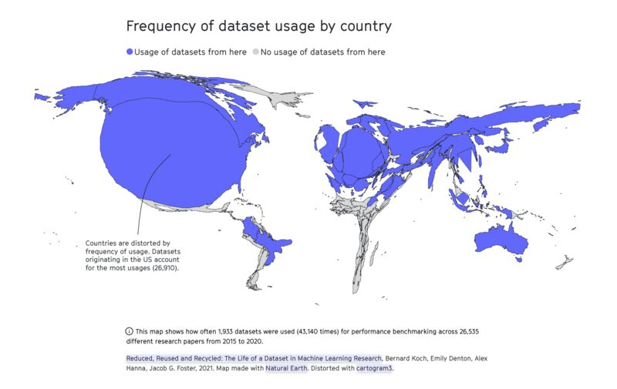
Ethical and data security considerations
AI-generated content is based on human choices, values, and flaws
Lack of diversity in training data
Environmental costs of GenAI (energy and water use)
by 2027, the annual electricity usage of AI servers could equal the annual electricity usage of the Netherlands or Sweden.¹
LLM could use up to 500 ml of water per 5-50 prompts.²
1. https://www.nytimes.com/2023/10/10/climate/ai-could-soon-need-as-much-electricity-as-an-entire-country.html
2. https://fortune.com/2023/09/09/ai-chatgpt-usage-fuels-spike-in-microsoft-water-consumption/?utm_source=www.joinsuperhuman.ai&utm_medium=newsletter&utm_campaign=ai-needs-a-lot-of-water

Slide 12
Ethical considerations
Exploitative labor to train GenAI models
‘Reinforcement learning through human feedback’ outsourced to low-wage employees in Kenya¹
Must review toxic and explicit content
Unequal accessibility
Cost of tools is a barrier
Particular GenAI tools may be restricted due to government regulation or censorship
Intellectual property issues
Do not enter copyrighted materials
Blurred boundaries of authorship and ownership → no clear-cut answers
1. https://time.com/6247678/openai-chatgpt-kenya-workers/

Slide 13
Best practices for ethical use of AI assistants
Avoid over-relying on the AI-coding assistant
Rigorous testing and validation
Use tools to automatically assess code quality and safety before deployment
Transparency and accountability in AI use
Acknowledge and cite AI-generated output in your work
Most publishers require disclosing the use of GenAI
Establish and follow clear guidelines

Slide 14

Current AI regulations in the EU
The AI Act (proposed in December 2023, approved on March 18, 2024)
Protection of Fundamental Rights
Ban on Certain AI Applications
Law Enforcement Exemptions
Obligations for High-Risk Systems
Transparency Requirements
Support for Innovation and SMEs
Notes:
The European Union has introduced regulations to govern the use of artificial intelligence, including generative AI.
It aims to protect fundamental rights, democracy, the rule of law and environmental sustainability from high-risk AI, while boosting innovation and establishing Europe as a leader in the field.
Protection of Fundamental Rights: The Act aims to safeguard fundamental rights, democracy, the rule of law, and environmental sustainability from high-risk AI applications while promoting innovation.
Ban on Certain AI Applications: Certain AI applications deemed threatening to citizens’ rights are prohibited. These include biometric categorization systems based on sensitive characteristics, untargeted scraping of facial images for recognition databases, emotion recognition in workplaces and schools, social scoring, predictive policing based solely on profiling, and AI that manipulates human behavior or exploits vulnerabilities.
Law Enforcement Exemptions: While biometric identification systems are generally prohibited for law enforcement, exceptions are allowed in narrowly defined situations, subject to strict safeguards such as judicial authorization.
Obligations for High-Risk Systems: High-risk AI systems, posing significant potential harm to health, safety, fundamental rights, etc., must adhere to obligations including risk assessment and mitigation, transparency, accuracy, and human oversight. Citizens have the right to submit complaints about AI systems affecting their rights.
Transparency Requirements: General-purpose AI systems must meet transparency requirements, including compliance with copyright law and publishing detailed training data summaries. Powerful AI models facing systemic risks will have additional evaluation and reporting requirements.
Support for Innovation and SMEs: Regulatory sandboxes and real-world testing will be established to support SMEs and startups in developing innovative AI solutions before market placement.

Slide 15
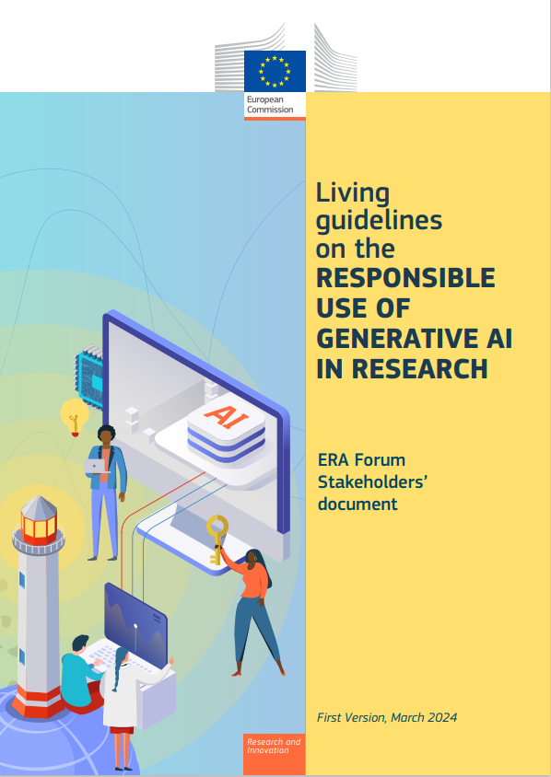
Current AI regulations in the EU (2)
Living guidelines on the responsible use of generative AI in research by the European Commission (March 2024)
Research Organizations:
Promote, guide, and support the responsible use of GAI;
Monitor and evaluate the development and use of GAI systems;
Reference or integrate GAI guidelines into general research guidelines;
Implement local or cloud-based GAI tools with adequate data protection measures.
Researchers:
Responsibility for scientific output;
Transparent GAI use;
Privacy, confidentiality, and intellectual property rights;
Legal and ethical standards;
Refrain from using GAI substantially in sensitive activities.

Slide 16
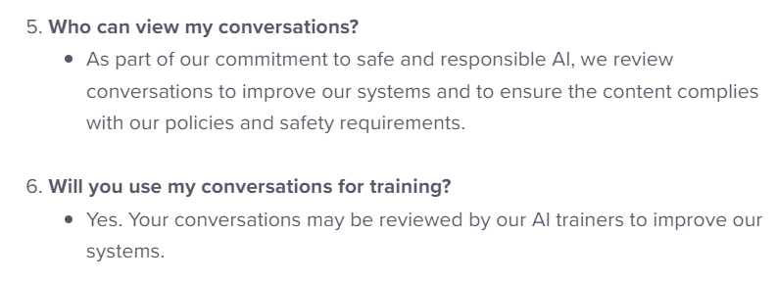

Data security
Random and systematic errors can undermine reliability
GitHub Copilot generated correct code only 46.3 percent of the time¹
Handling sensitive research and personal data
Your input will probably be used to further train the GenAI tools
Data is processed and stored on US servers
https://help.openai.com/en/articles/6783457-chatgpt-general-faq
https://businessinsider.com/amazon-chatgpt-openai-warns-employees-not-share-confidential-information-microsoft-2023-1
1. Yetistiren, B., Ozsoy, I. and Tuzun, E., 2022, November. Assessing the quality of GitHub copilot’s code generation. In Proceedings of the 18th international conference on predictive models and data analytics in software engineering (pp. 62-71).

Slide 17
Security measures
Use offline AI tools
TabNine can be run locally without the need for Internet access
Training a LLaMA model locally, which allows for a customized coding assistant
Code review processes for potential vulnerabilities and errors
Secure development practices
Access controls and data encryption to protect sensitive code bases
Prevents unauthorized access → reducing the risk of data breaches or malicious tampering.
Continuous monitoring and updates
Automate updates and ensure that the latest security practices are consistently applied → minimize the introduction of vulnerabilities
Collaborative Oversight
Regular code reviews can promote collective responsibility, enhancing code quality through diverse perspectives
Notes:
Secure development practices
Automated testing can identify security holes early in the development process, while training sessions help developers remain vigilant against insecure practices suggested by artificial intelligence.
Collaborative Oversight
Multiple perspectives help identify potential flaws that an individual developer might overlook. Implementing regular code reviews can foster an environment of collective responsibility, enhancing code quality through diverse perspectives.

Slide 18
AI coding assistant ethics challenge (15 min)
List at least two potential risks or vulnerabilities that could arise from using an AI coding assistant in this project.
For each risk identified, propose a specific mitigation strategy. Explain how this strategy addresses the risk and aligns with the best practices discussed in the lesson.
Draft a set of at least 5 ethical guidelines for your team to follow when using the AI coding assistant. These should cover areas such as bias prevention, code review processes, and data privacy.
Outline a security protocol that includes at least three specific measures to protect sensitive data and ensure the integrity of the AI-assisted development process.
Design a collaborative code review process that leverages the strengths of both human developers and the AI assistant while mitigating potential risks.
Let’s discuss your results!
Notes:
You’re leading a team that’s considering adopting an AI coding assistant for a new project involving sensitive user data. Your task is to create a comprehensive plan that addresses the ethical and security concerns discussed in the lesson.

Slide 19
Key takeaways
Code generation and optimization using Chat, Command, and Autocomplete functions of Codeium
Follow best practices (e.g., always review generated code) and be cautious with sensitive data
Be aware of potential biases in AI-generated code and ensure ethical coding practices
Use AI as a tool to augment, not replace, your coding skills!
What are your questions?

Slide 20
Workshop feedback
Survey: here will be a QR code to a feedback form

Slide 21



Giulia Crocioni g.crocioni@esciencecenter.nl
Thank you for your participation!
Olga Minaeva
o.minaeva@nwo-i.nl

